Slide 1
Exploring ML/AI techniques in Human Resource Management
Professional Certificate in Machine Learning and Artificial Intelligence - UC Berkeley
Armando Cova
October 2024

Slide 2

Motivation
Employment engagement and satisfaction (among other HR indicators) are key for driving positive business outcomes
Tools capable of reliably analyzing and predicting key HR indicators could help organizations achieve their business objectives and reduce costs by providing actionable information for tailoring HR management policies to improve productivity and enhance employee experiences
ML and AI have emerged as powerful data analysis and interpretation tools that could be successfully applied in the HR realm

Slide 3
Objectives
Follow the main tenants of the CRISP-DM methodology to explore the application of ML techniques to HR management
Study employee absenteeism using a publicly available information database created with records of absenteeism at work from July 2007 to July 2010 at a courier company in Brazil (link)

Slide 4
Materials and Methods
Identified categorical and numerical features on the database which influenced employee absenteeism
Performed statistical data analyses on the data to gain insights into how these factors affected absenteeism
Performed modeling studies with known classification methods (Decision Tree, Logistic Regression, KNN, SVM, Random Forest, etc) to develop preliminary models for predicting employee absences deemed significant (> 4 hr). Compared model performance across several metrics (accuracy, recall, precision, F1 scores)

Slide 5

Exploratory data analysis: Summary of Main results - 1
The total number of absenteeism hours was 5124.
The average absence time was 7.4 hr. The STD was 13.6 hr.
Half of the absent workers were away for 3 hr or less
The maximum absence time was 120 hr (15 days)
The average Service time of absentees was 12.6 years with minimum of 1 and a maximum of 29 years. 75% of absentees had less than 16 years of service.
The mean Age of absentees was 36.3 years with a minimum of 27 years and a maximum of 58 years. 75% of absentees were younger than 40 yo
The average distance from their residence location to work for absentees was 29.9 Km
There were 44 individuals with perfect attendance record (6% of total)
By extension, 94% of individuals reported absences during the year

Slide 6

Exploratory data analysis: Summary of Main results - 2
The main reasons for absences were medical consultation (21.4%), dental consultation (16.1%), physiotherapy(9.8%), diseases of the musculoskeletal system and connective tissue (7.9%), injuries (5.7%) and patient follow-up(5.5%)
The majority of absent hours were caused by diseases of the musculoskeletal system and connective tissue (842 hr); injury, poisoning and certain other consequences of external causes (729 hr); as well as medical(424 hr) and dental(335 hr) consultations. There were significant absences due to diseases of the respiratory(276 hr) and digestive(297 hr) systems.
The months with the most absenteeism cases were March (12%), February (10.3%) and July (9.3%)
The months with the most absenteeism time were March (765 hr), July (734 hr), April (482 hr) and November (473 hr)
The days with the most absence cases were Monday (22.1%), Wednesday (20.8%), Tuesday (20.3%) and Friday (19.8%)
The days with the most absenteeism hours were Monday (1489 hr), Tuesday (1229 hr), Wednesday (1115 hr) and Friday (738 hr)
Absence cases were almost equally distributed across seasons with Autumn having a slight uptick (27.2%)
The season with the most absenteeism hours was Autumn (1492 hr), followed by Spring (1241) and Winter (1239) which differed very little.
None of the absentees were subject to disciplinary action prior to being absent

Slide 7

Exploratory data analysis: Summary of Main results - 3
The majority of the absentees (82%) had high school education. Employees with this level of education had the most absenteeism hours (4393 hr)
A large majority of absentees (58.5%) had children
The largest number of absenteeism hours were seen in employees with 2 children (1649 hr)
56.2 percent of absentees were social drinkers. The largest number of absenteeism hours were in the social drinker group (3226 hr)
6.6 percent of absentees were social smokers. The largest number of absenteeism hours were in the non-smoker group (4773 hr)
37.8% of absenteeism cases were found in employees who owned pets. The total number of absenteeism hours for pet owners was 1983 hr. The largest number of hours belonged to the no-pet ownership group (3141 hr)
32.2% of absenteeism cases were found in employees with obesity. The total number of absenteeism hours for these employees was 1461 hr
31.9% of absenteeism cases were found in employees who were overweight. The total number of absenteeism hours for these employees was 1931 hr.

Slide 8
Exploratory data analysis: Summary of Main results - 4
40.4% of absenteeism cases were found in employees who were younger than 35 years old. 38.8% of cases were found in the 35 to 40 years old bracket
The largest number of absence hours (1777 hr) were found in the 33-40 year old bracket
43.7% of absenteeism cases were found in employees with a 240 to 250 Workload average a day
61.5% of absentees had a transportation expense between 175 and 280
67.7% of absentees live 25 Km or farther from work. The largest group of absentees (27.9%) live 50+ Km from work
88.9% of absences were in employees with 9 to 18 years of service
The largest number of absence hours (3182 hr) were found in the group with 9-14 years of service

Slide 9
Modeling absenteeism: Development methods 1
Identified suitable numeric and categorical data features for modeling
Numerical features were normalized
Categorical features were hot-encoded
Modeling data was split using a 80/20 train/test segment ratio
Used SMOTE to mitigate observed significant class imbalance in the target variable
Models were built using state-of-the-art classification methods (KNN, Decision Tree, Logistic Regression, SVM, Random Forest, Ada Boost, Gradient Boost and Naïve Bayes)

Slide 10
Modeling absenteeism: Development methods 2
Models were trained on the train data segment and validated on the test data using K-fold cross-validation
Hyperparameter searches on the different estimators were carried out using different methods (GridSearch, RadomizedSearch, BayesianSearch)in an attempt to optimize performance for accuracy, precision and F1 scores
The predictive performance of the models was compared based on accuracy, precision, recall and F1-score metrics
Used recursive feature elimination to identify model features with the largest predictive power

Slide 11
Modeling results – Optimized for Accuracy
 | Test Accuracy | Test Recall | Test Precision | Test F1 Score
Classifier
LogisticRegression | 0.63 | 0.51 | 0.62 | 0.56
KNN | 0.72 | 0.73 | 0.68 | 0.70
DecisionTree | 0.70 | 0.65 | 0.69 | 0.67
SVM | 0.65 | 0.64 | 0.62 | 0.63
RandomForest | 0.73 | 0.71 | 0.71 | 0.71
AdaBoost | 0.69 | 0.61 | 0.68 | 0.65
GradientBoost | 0.74 | 0.73 | 0.70 | 0.72
NBayes | 0.58 | 0.31 | 0.58 | 0.40

Slide 12
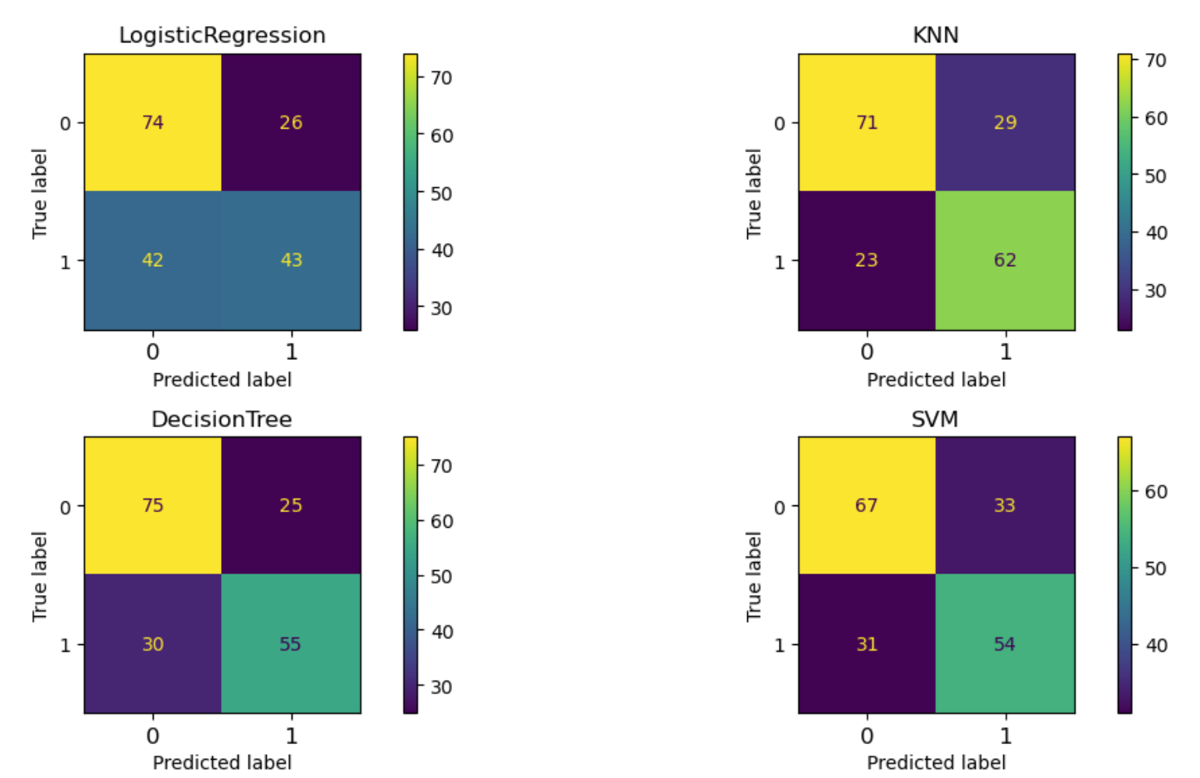
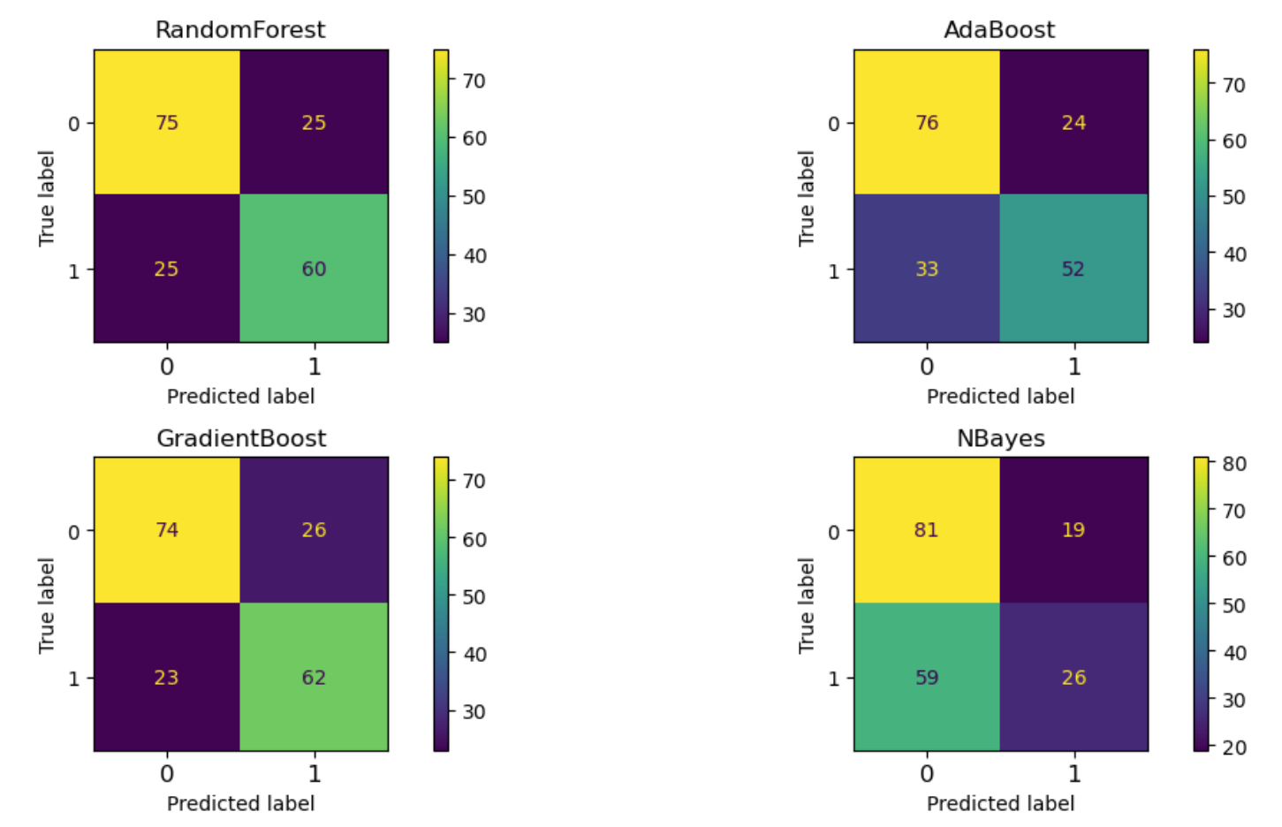
Confusion matrices – Models optimized for accuracy

Slide 13
Modeling results – Optimized for Precision
 | Test Accuracy | Test Recall | Test Precision | Test F1 Score
Classifier
LogisticRegression | 0.63 | 0.51 | 0.62 | 0.56
KNN | 0.69 | 0.51 | 0.74 | 0.60
DecisionTree | 0.70 | 0.65 | 0.69 | 0.67
SVM | 0.65 | 0.64 | 0.62 | 0.63
RandomForest | 0.70 | 0.69 | 0.66 | 0.68
AdaBoost | 0.68 | 0.60 | 0.66 | 0.63
GradientBoost | 0.67 | 0.59 | 0.66 | 0.62
NBayes | 0.58 | 0.31 | 0.58 | 0.40

Slide 14
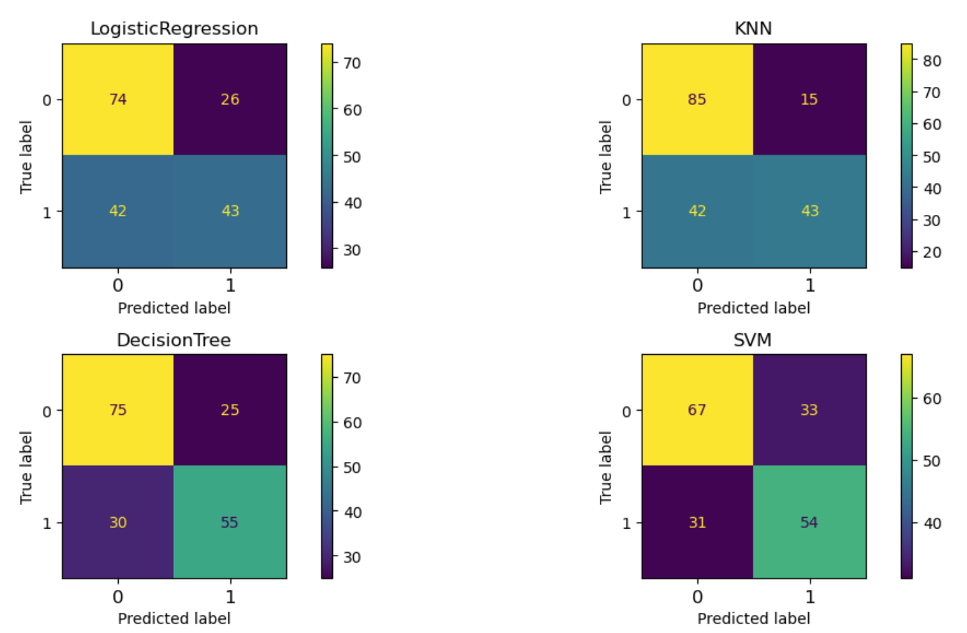
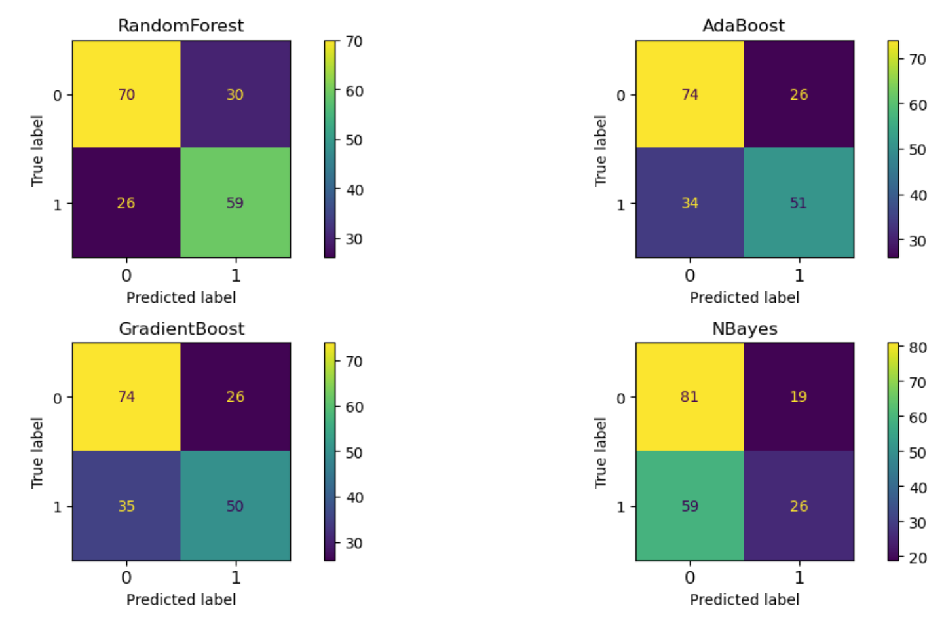
Confusion matrices – Models optimized for precision

Slide 15
Modeling results – Optimized for F1-score
 | Test Accuracy | Test Recall | Test Precision | Test F1 Score
Classifier
LogisticRegression | 0.61 | 0.52 | 0.58 | 0.55
KNN | 0.72 | 0.73 | 0.68 | 0.70
DecisionTree | 0.71 | 0.65 | 0.71 | 0.67
SVM | 0.52 | 0.93 | 0.49 | 0.64
RandomForest | 0.70 | 0.69 | 0.66 | 0.68
AdaBoost | 0.68 | 0.60 | 0.66 | 0.63
GradientBoost | 0.74 | 0.74 | 0.71 | 0.72
NBayes | 0.58 | 0.31 | 0.58 | 0.40

Slide 16
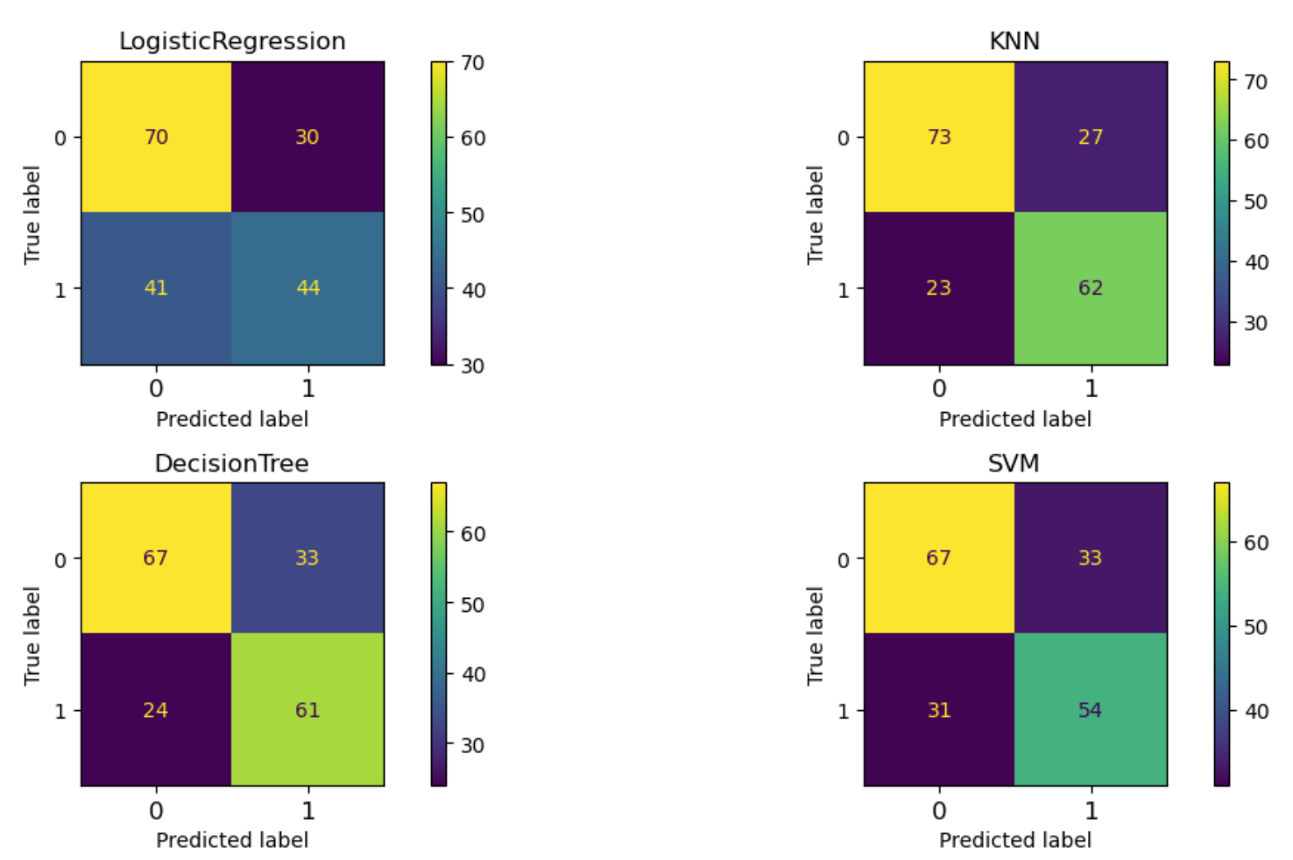
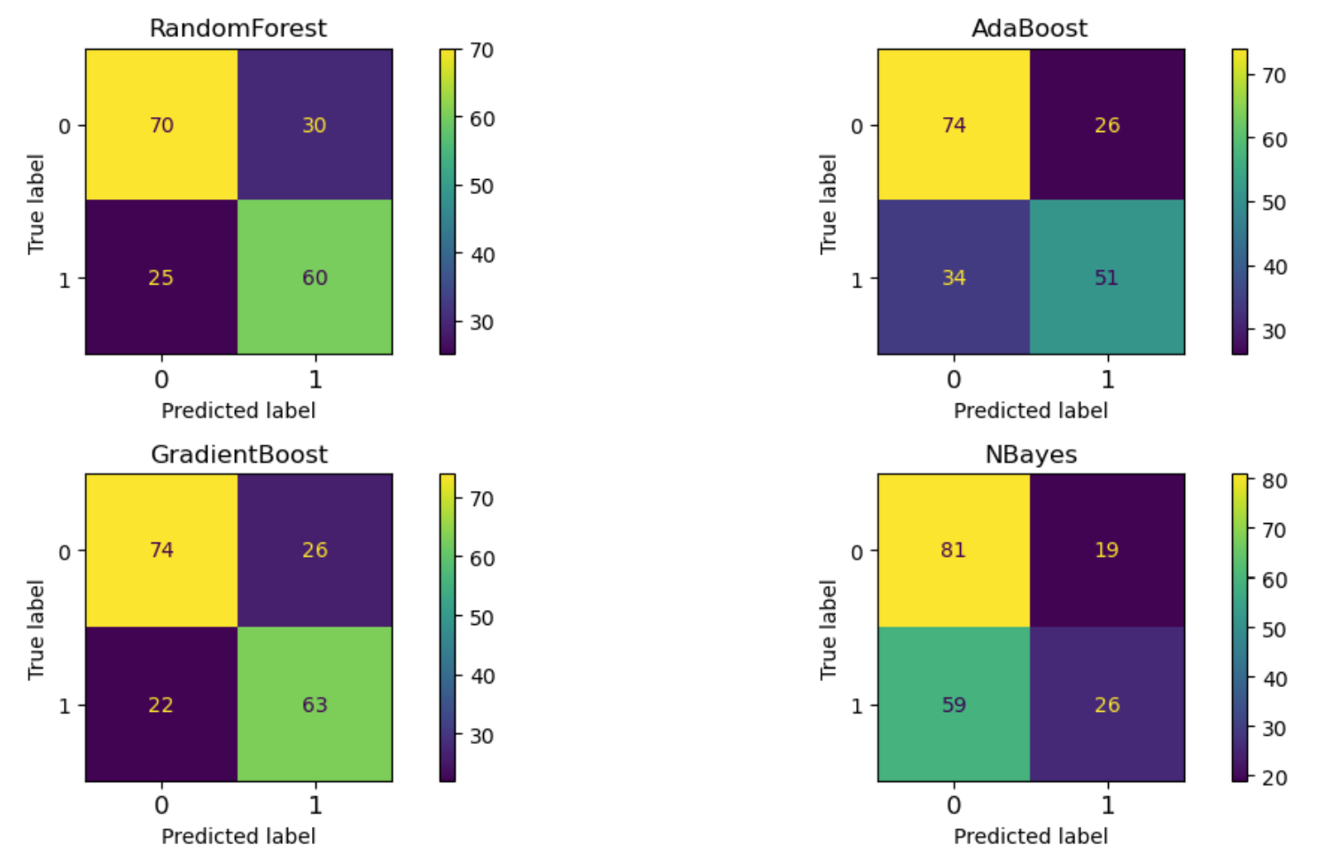
Confusion matrices – Models optimized for F1-score

Slide 17
Modeling results summary
Model optimization based on the accuracy metric produce the best over-all performance results
The best performing models in terms of accuracy were Gradient Boost (74%), Random Forest (73%) and KNN (72%)
The best performing models in terms of precision were Random Forest (71%), Gradient Boost (70%) and Decision Tree (69%)
The best performing models in terms of F1-score were Gradient Boost (72%), Random Forest (71%), and KNN (70%)
RFE selection results suggested ‘Transportation expense’, ‘Distance from Residence to Work’, ‘Service time’, ‘Age’, ‘Work load Average/day’ and ‘Body mass index’ as the features with the largest predictive power

Slide 18

Conclusions and Recommendations - 1
The main reasons for employee absenteeism were related to health issues, either the need for follow-up medical, dental and rehabilitation care or employee health conditions including diseases and injuries
It is recommended that the company implements wellness programs that focus on physical and mental health to help employees stay healthy and reduce absenteeism due to illness
It is recommended that the company reviews and enhances its safety policies and procedures to reduce occupational hazards to prevent absences due to work related injuries/illnesses
It is recommended that the company offers medical and dental services on-site to help reduce absenteeism due to employees having to travel to seek medical/dental care

Slide 19
Conclusions and Recommendations -2
It is recommended that the company implements fitness programs such as gym memberships or on-site fitness classes to promote physical health and endurance to reduce absence days
It is recommended that the company implements healthy meal options at its cafeteria to help employees maintain energy levels and a healthy weight
The tier-1 models developed in this study had an accuracy >= 72% which makes them useful in predicting employee absences, exceeding the predictive abilities of other ad-hoc methods

Slide 20

References
Martiniano, A. & Ferreira, R. (2012). Absenteeism at work [Dataset]. UCI Machine Learning Repository. https://doi.org/10.24432/C5X882.
Martiniano A., Ferreira R.P., Sassi R., Affonso C. (2012). Application of a neuro fuzzy network in prediction of absenteeism at work Iberian Conference on Information Systems and Technologies
Cova A. (2024). Capstone project: Developing models for predicting absenteeism at work. Professional Certificate in Machine Learning and Artificial Intelligence, UC Berkeley

Slide 21

Data Analysis Visualizations

Slide 22
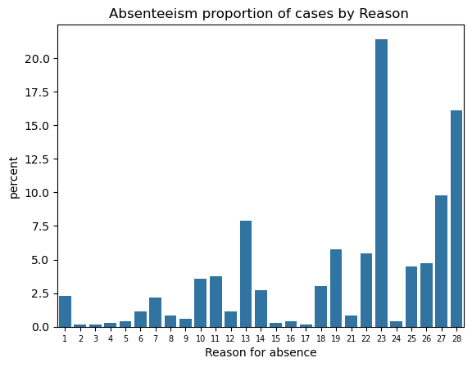
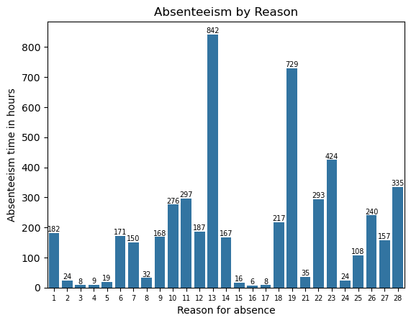
Exploratory Data Analysis: Reason for absence

Slide 23
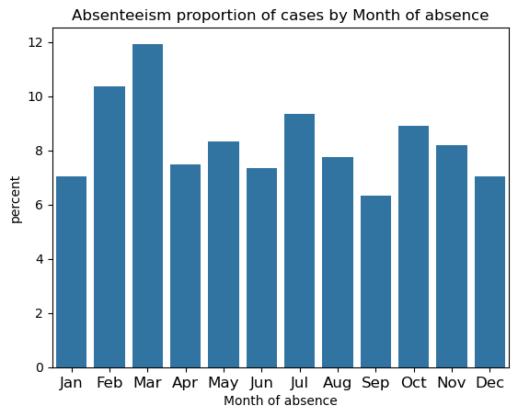
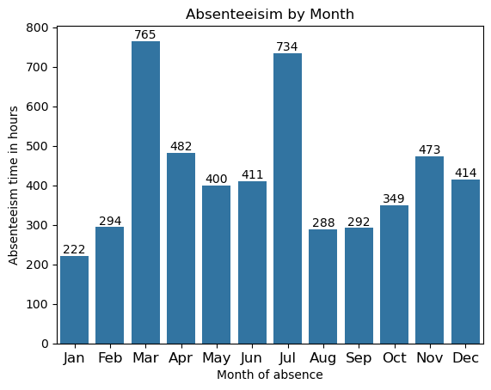
Exploratory Data Analysis: Month of absence

Slide 24
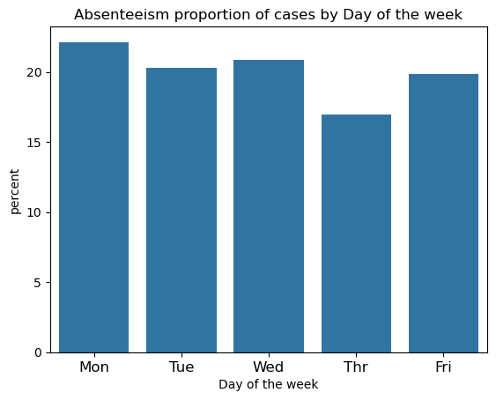
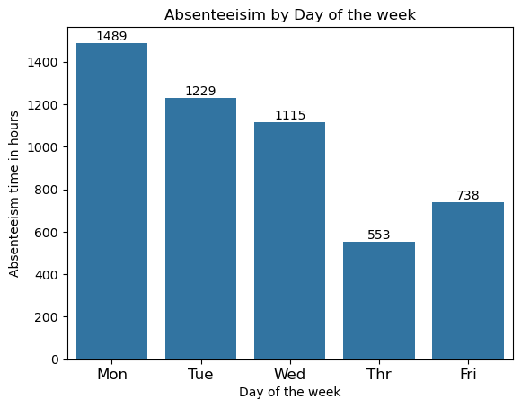
Exploratory Data Analysis: Day of the week

Slide 25
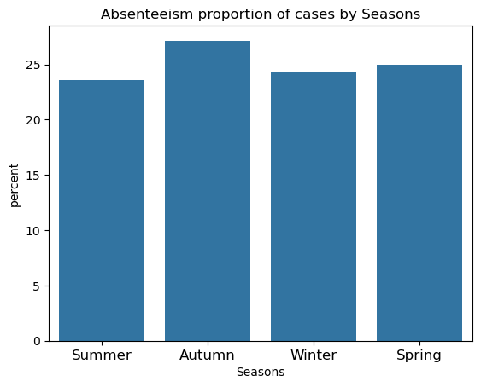
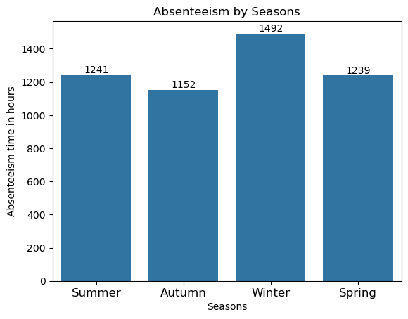
Exploratory Data Analysis: Seasons

Slide 26
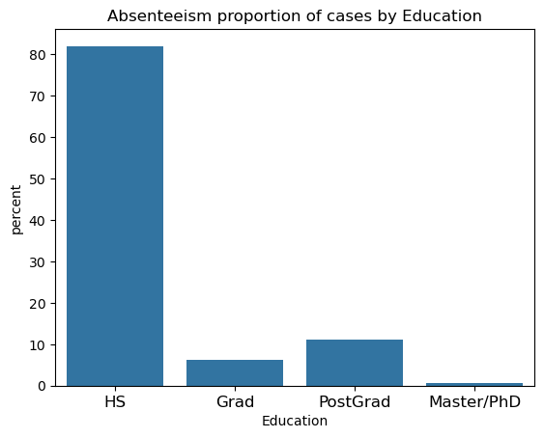
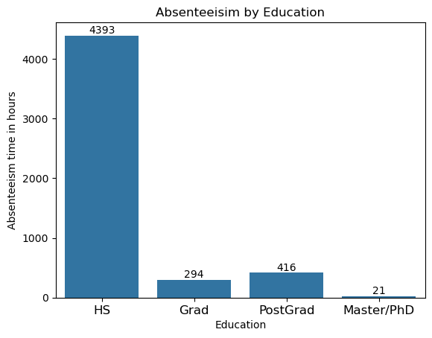
Exploratory Data Analysis: Education

Slide 27
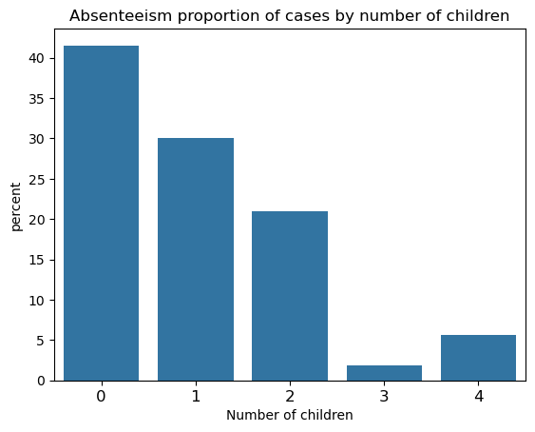
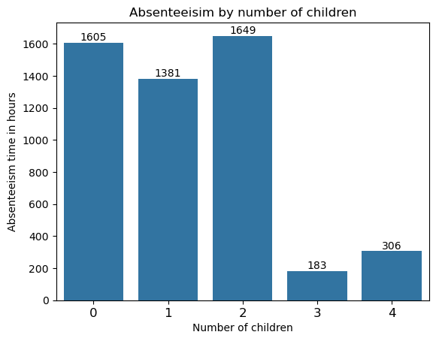
Exploratory Data Analysis: Number of children

Slide 28
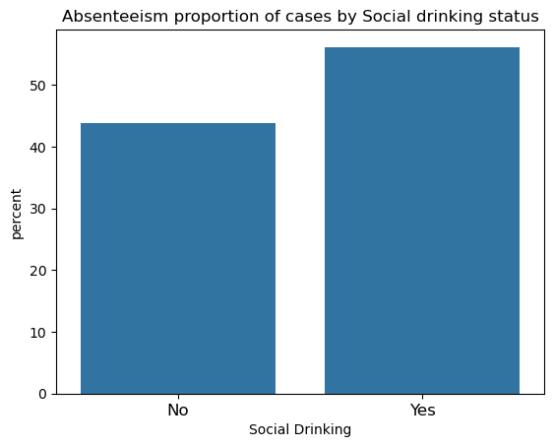
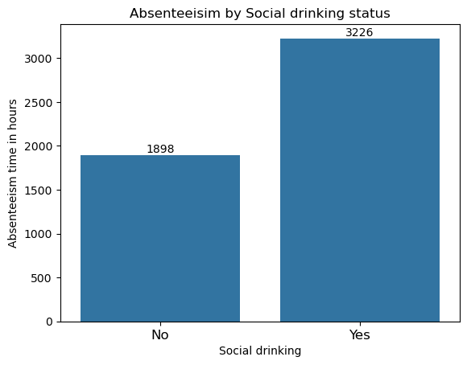
Exploratory Data Analysis: Social drinking status

Slide 29
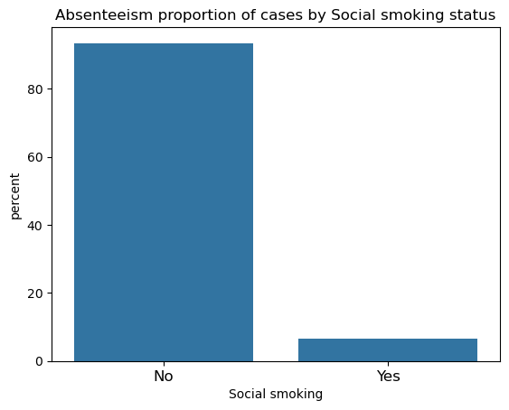
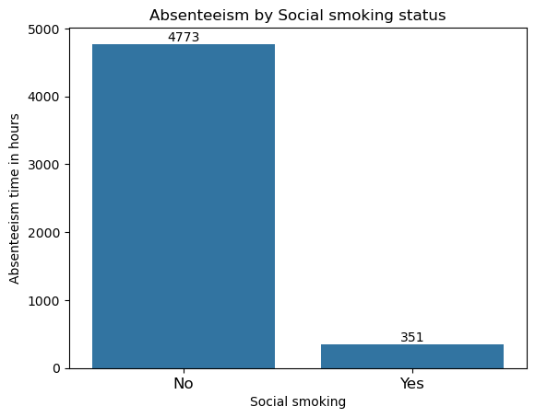
Exploratory Data Analysis: Social smoking status

Slide 30
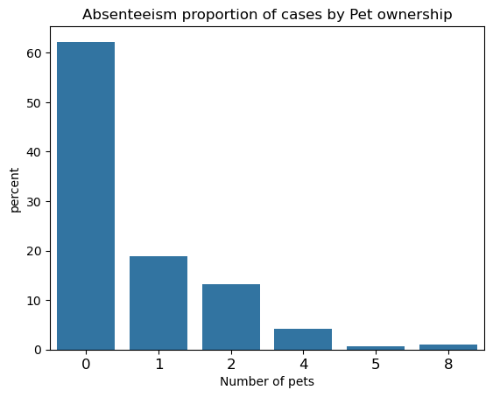
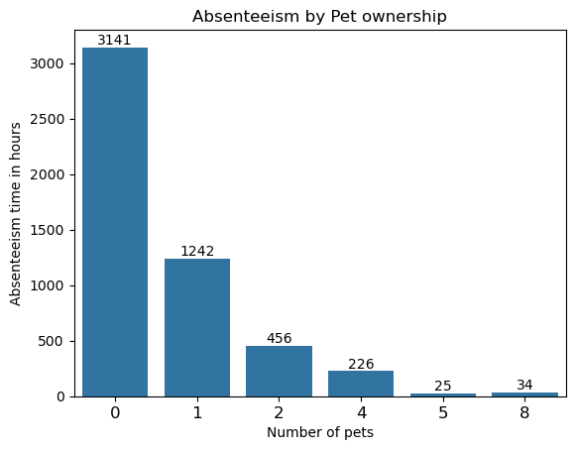
Exploratory Data Analysis: Pet ownership

Slide 31
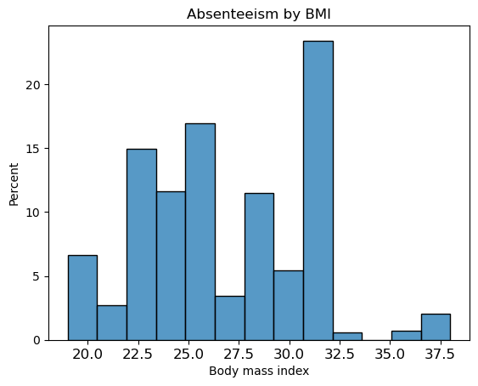
Exploratory Data Analysis: BMI

Slide 32
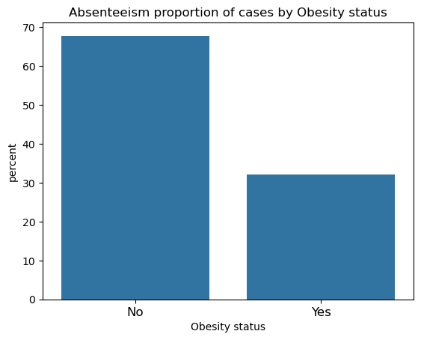
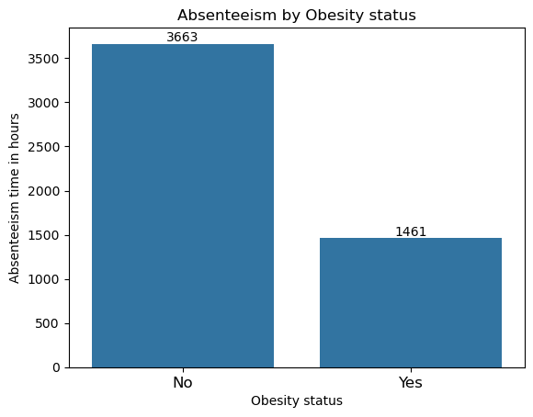
Exploratory Data Analysis: Obesity status

Slide 33
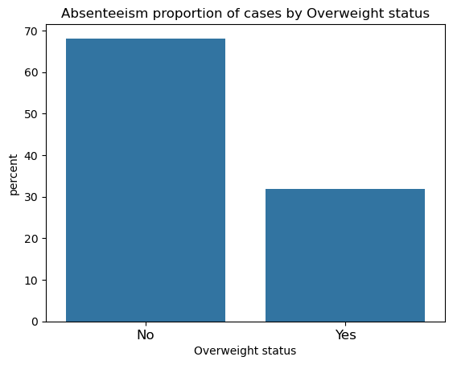
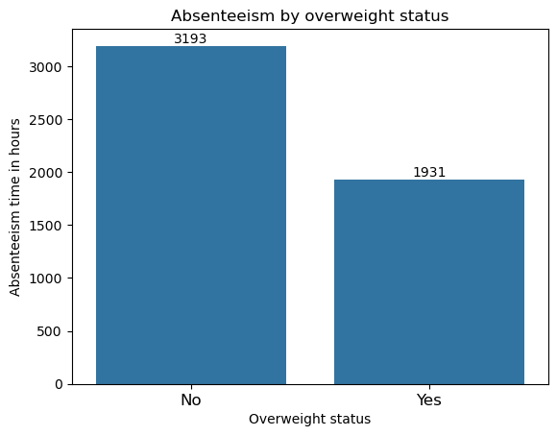
Exploratory Data Analysis: Overweight status

Slide 34
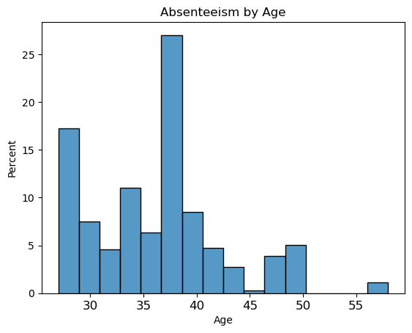
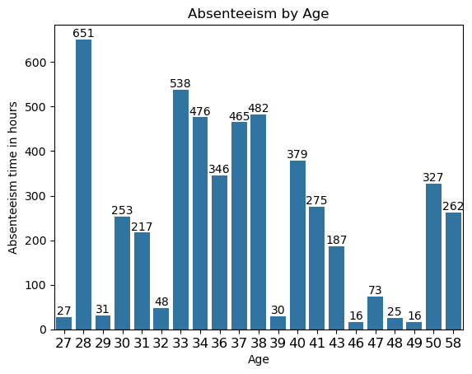
Exploratory Data Analysis: Employee Age

Slide 35
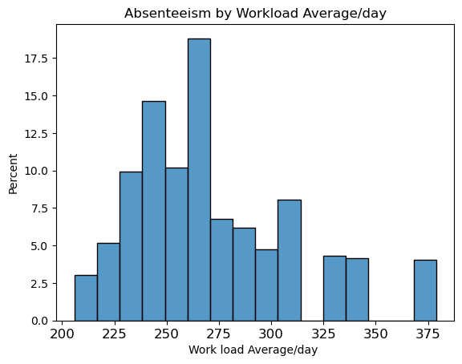
Exploratory Data Analysis: Workload Average

Slide 36
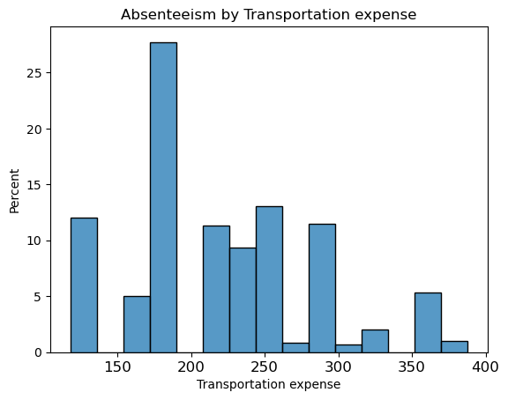
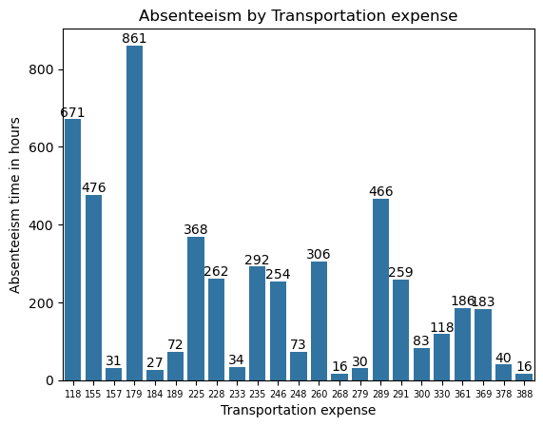
Exploratory Data Analysis: Transportation Expense

Slide 37
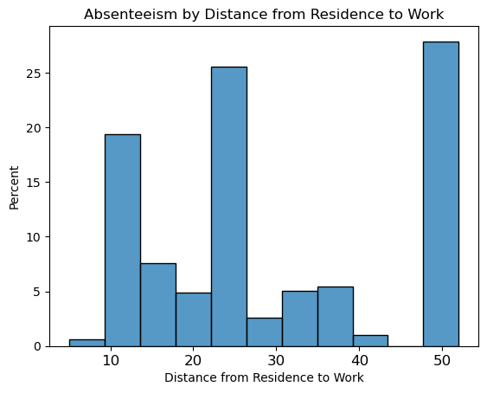
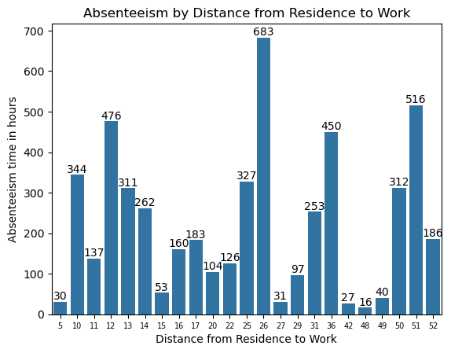
Exploratory Data Analysis: Distance from Residence to Work

Slide 38
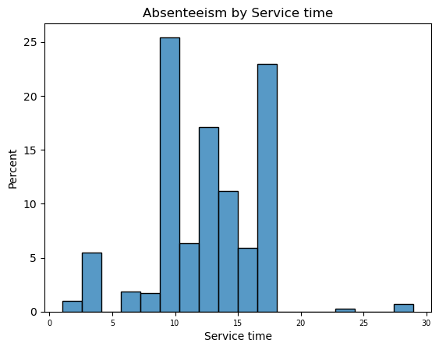
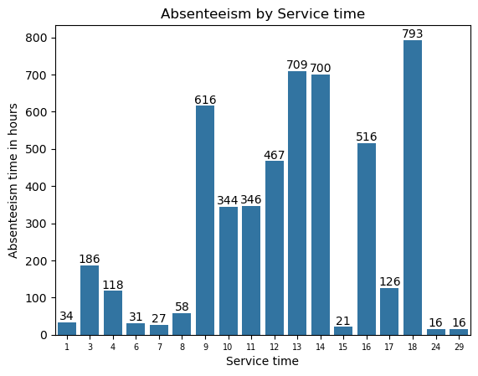
Exploratory Data Analysis: Service Time

